Slide 1
Unit V
Parallelism

Slide 2
Syllabus
Need, types, applications and challenges, Architecture of Parallel Systems – Flynn’s classification; ARM Processor: The thumb instruction set, Processor and CPU cores, Instruction Encoding format, Memory load and Store instruction, Basics of I/O operations. Case study: ARM 5 and ARM 7 Architecture

Slide 3
Parallelism
Why parallelism? – ticket counter example.
Executing two or more operations at the same time is known as parallelism.
Parallel processing is a method to improve computer system performance by executing two or more instructions simultaneously
A parallel computer is a set of processors that are able to work cooperatively to solve a computational problem.
Two or more ALUs in CPU can work concurrently to increase throughput
The system may have two or more processors operating concurrently

Slide 4
Goals of parallelism
To increase the computational speed (ie) to reduce the amount of time that you need to wait for a problem to be solved
To increase throughput (ie) the amount of processing that can be accomplished during a given interval of time
To improve the performance of the computer for a given clock speed
To solve bigger problems that might not fit in the limited memory of a single CPU

Slide 5
Applications of Parallelism
Numeric weather prediction
Socio economics
Finite element analysis
Artificial intelligence and automation
Genetic engineering
Weapon research and defence
Medical Applications
Remote sensing applications

Slide 6
Types of parallelism
1. Hardware Parallelism
2. Software Parallelism

Slide 7
Hardware Parallelism :
Objective – to increase the processing speed.
Based on the hardware architecture (2 types):
Processor parallelism and
Memory parallelism.

Slide 8
Processor parallelism – the computer architecture has multiple nodes, multiple CPUs or multiple sockets, multiple cores, and multiple threads.
Memory parallelism – shared memory, distributed memory, hybrid distributed shared memory, multilevel pipelines, etc.
Otherwise called Parallel Random Access Machine (PRAM).
“It is an abstract model for parallel computation which assumes that all the processors operate synchronously under a single clock and are able to randomly access a large shared memory”.
In particular, a processor can execute an arithmetic, logic, or memory access operation within a single clock cycle.
Overlapping or pipelining instructions are used to achieve parallelism.

Slide 9
Hardware Parallelism
One way to characterize the parallelism in a processor is by the number of instruction issued per machine cycle.
If a processor issues k instructions per machine cycle, then it is called a k-issue processor.
In a modern processor, two or more instructions can be issued per machine cycle.
A conventional processor takes one or more machine cycles to issue a single instruction. These types of processors are called one-issue machines, with a single instruction pipeline in the processor.
A multiprocessor system which built n k-issue processors should be able to handle a maximum of nk threads of instructions simultaneously

Slide 10
Software Parallelism
It is defined by the control and data dependence of programs.
The degree of parallelism is revealed in the program flow graph.
Software parallelism is a function of algorithm, programming style, and compiler optimization.
The program flow graph displays the patterns of simultaneously executable operations.
Parallelism in a program varies during the execution period .
It limits the sustained performance of the processor.

Slide 11
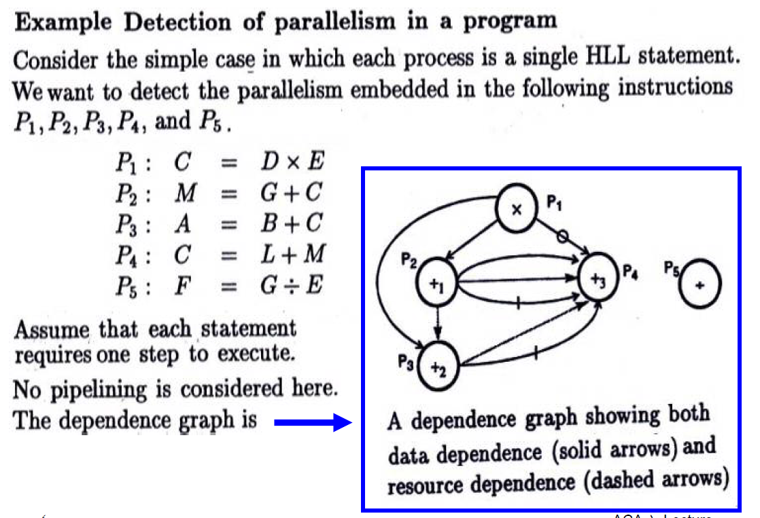

Slide 12
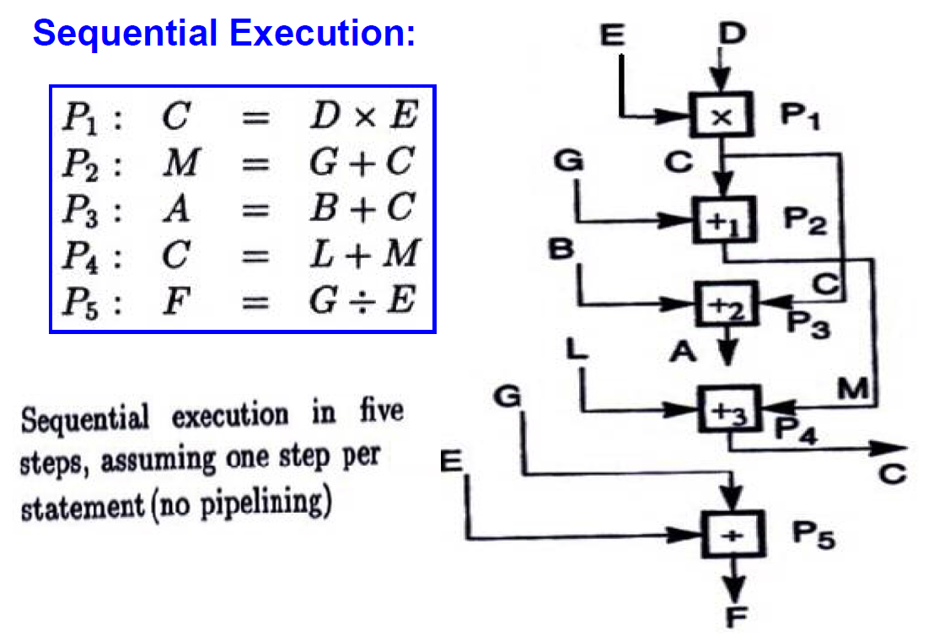

Slide 13
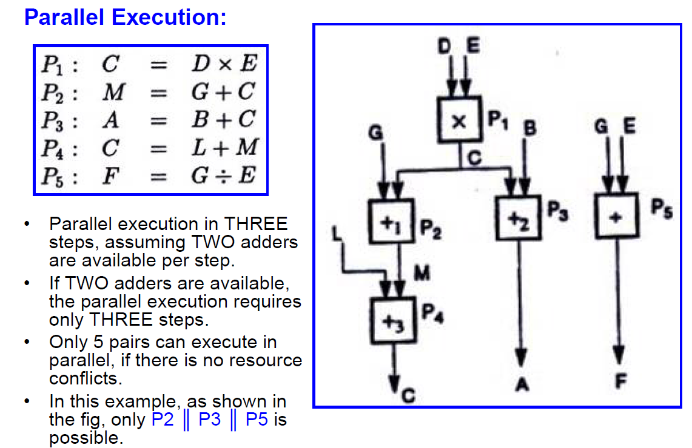

Slide 14
Flynn’s Classification
Was proposed by researcher Michael J. Flynn in 1966.
It is the most commonly accepted taxonomy of computer organization.
In this classification, computers are classified by whether it processes a single instruction at a time or multiple instructions simultaneously, and whether it operates on one or multiple data sets.

Slide 15
Flynn’s Classification
This taxonomy distinguishes multi-processor computer architectures according to the two independent dimensions of Instruction stream and Data stream.
An instruction stream is sequence of instructions executed by machine.
A data stream is a sequence of data including input, partial or temporary results used by instruction stream.
Each of these dimensions can have only one of two possible states: Single or Multiple.
Flynn’s classification depends on the distinction between the performance of control unit and the data processing unit rather than its operational and structural interconnections.

Slide 16
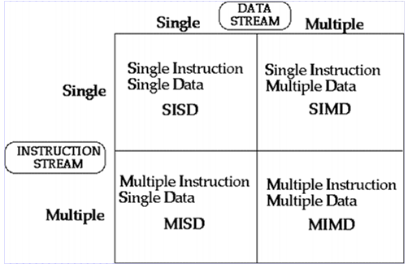
Flynn’s Classification
Four category of Flynn classification

Slide 17
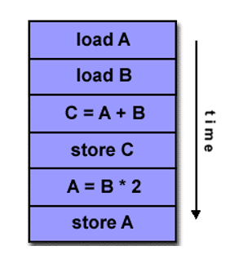

SISD
They are also called scalar processor i.e., one instruction at a time and each instruction have only one set of operands.
Single instruction: only one instruction stream is being acted on by the CPU during any one clock cycle.
Single data: only one data stream is being used as input during any one clock cycle.
Deterministic execution.
Instructions are executed sequentially.
SISD computer having one control unit, one processor unit and single memory unit.

Slide 18
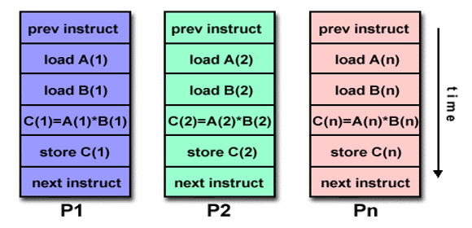
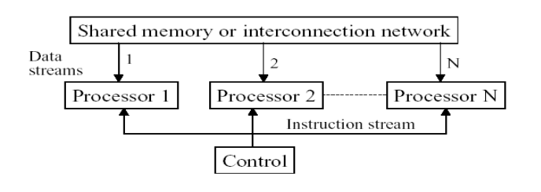
SIMD
A type of parallel computer.
Single instruction: All processing units execute the same instruction issued by the control unit at any given clock cycle .
Multiple data: Each processing unit can operate on a different data element as shown if figure below the processor are connected to shared memory or interconnection network providing multiple data to processing unit
single instruction is executed by different processing unit on different set of data

Slide 19
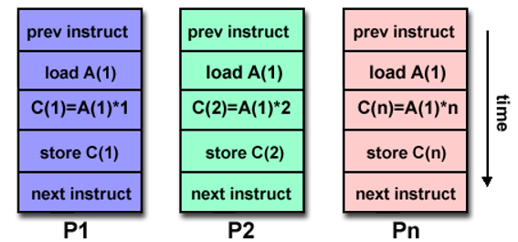
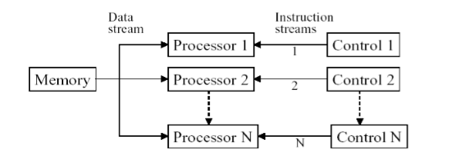
MISD
A single data stream is fed into multiple processing units.
Each processing unit operates on the data independently via independent instruction.
A single data stream is forwarded to different processing unit which are connected to different control unit and execute instruction given to it by control unit to which it is attached.
same data flow through a linear array of processors executing different instruction streams

Slide 20
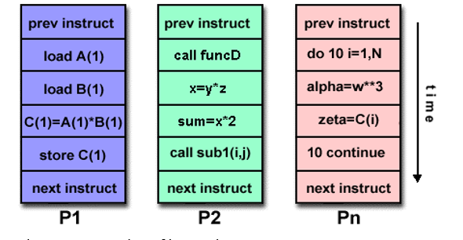
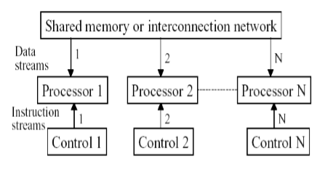
MIMD
Multiple Instruction: every processor may be executing a different instruction stream.
Multiple Data: every processor may be working with a different data stream.
Execution can be synchronous or asynchronous, deterministic or nondeterministic
Different processor each processing different task.

Slide 21
ARM processor
ARM – Advanced RISC Machine.
Family of CPU used in music players, smartphones, wearables, tablets and other electronic devices.
Very few instruction sets and transistors are needed.
Small in size – perfectly fits small devices.
Less power consumption and complexity.
Can be applied to 32-bit systems and embedded systems.

Slide 22
Processing unit works on a set of predefined instructions – collectively called Instruction Sets.
OS and programs uses these instructions to execute themselves.
Later it was found that the many instructions were not that much used by the processor.
So, reducing the number of predefined instructions and the cutting out the hard to implement and complex instructions – RISC was formed.
This caused the processor to run faster and used less power and space on chip.

Slide 23
X86 processor – modular approach
→uses graphics card, memory control, etc.
→but costly and high hardware components.

Slide 24
In ARM processor, CPU cores are the part of the physical platform.
Other hardware functions are on the same platform.
All these are integrated through an internal bus.
This is SOC (System On a Chip)
ARM just gives a structure and the owning company can frame its own required structure around the ARM processor.

Slide 25
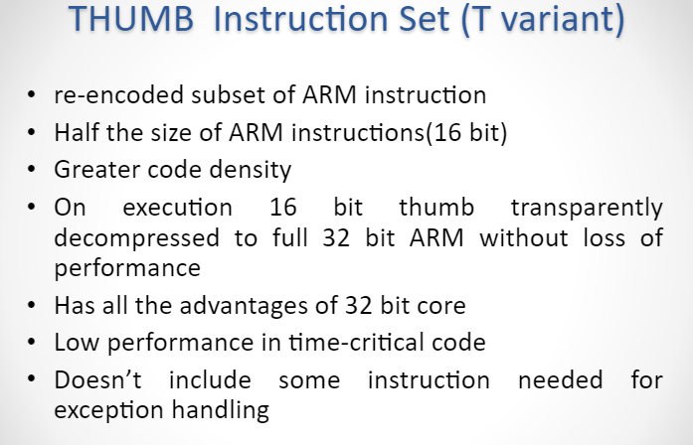

Slide 26
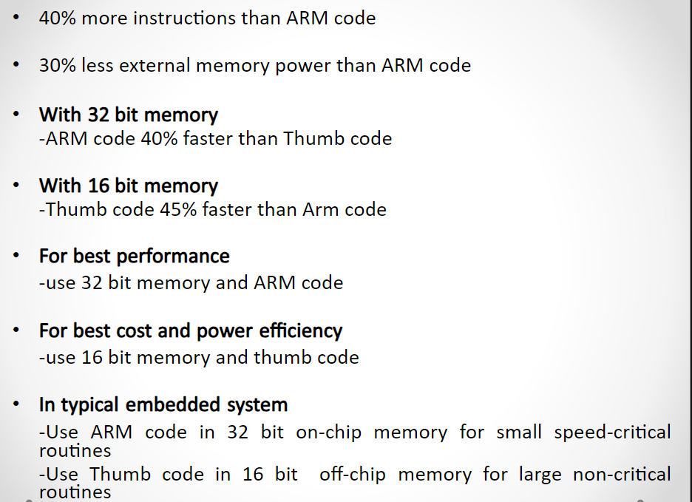
Thumb instruction set (T variant) Contd….

Slide 27
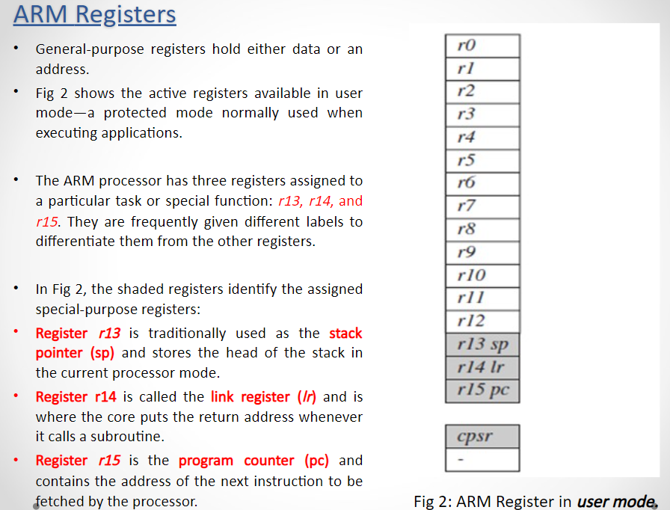

Slide 28
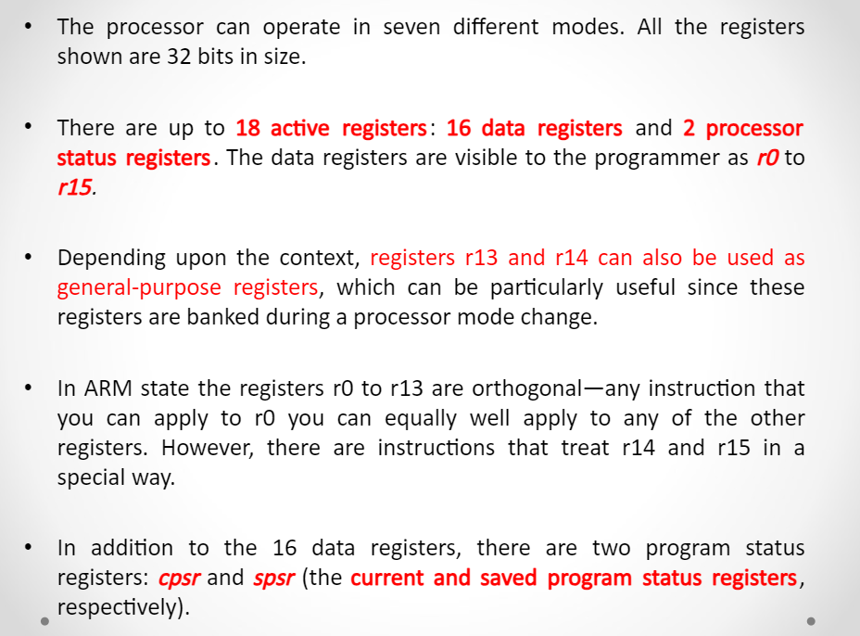

Slide 29
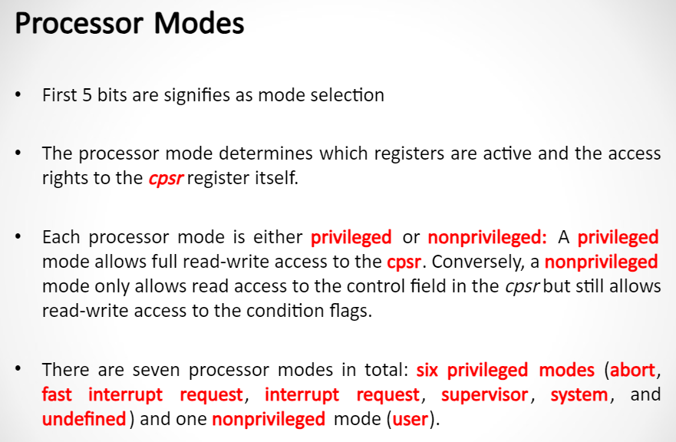

Slide 30
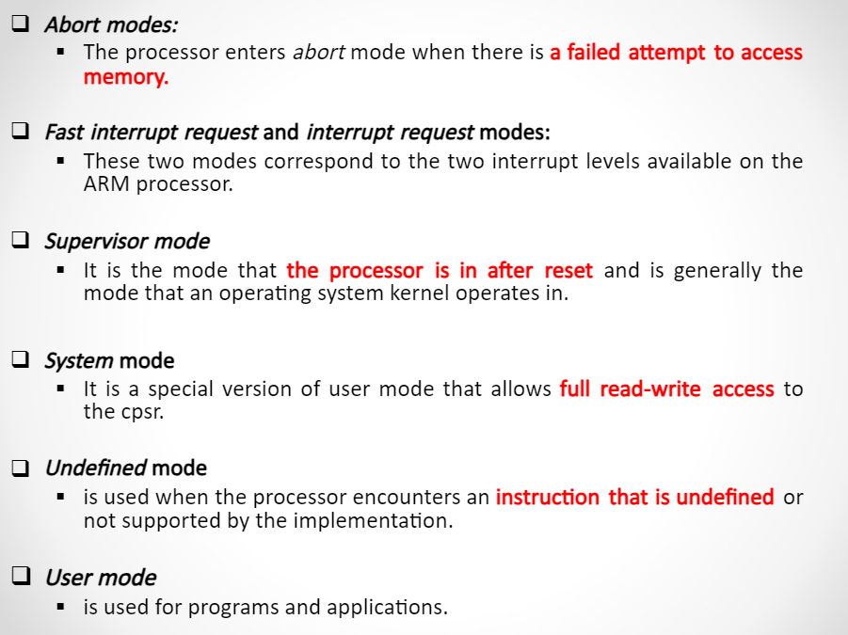

Slide 31
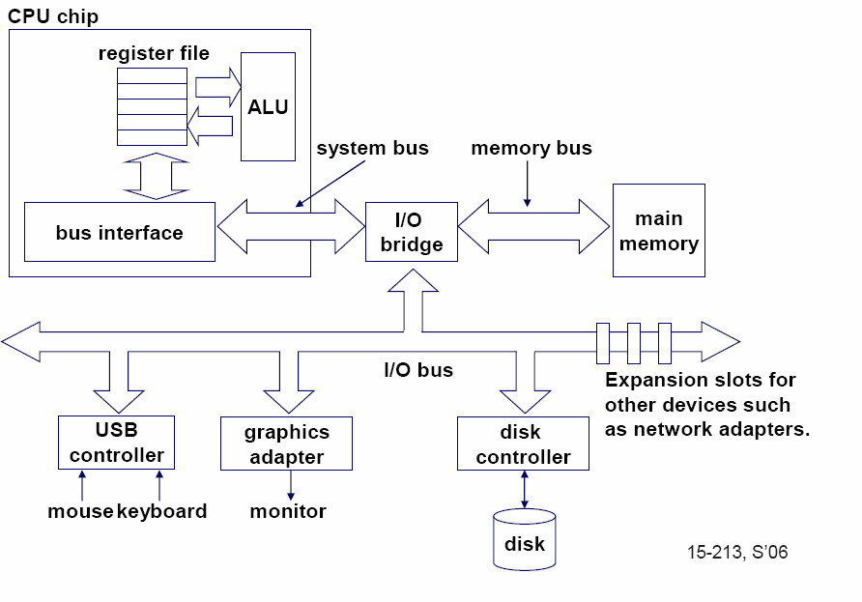
Single-core computer

Slide 32
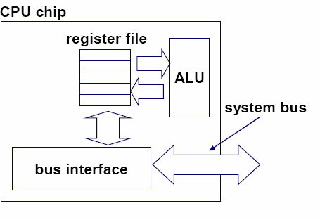
Single-core CPU chip
the single core

Slide 33
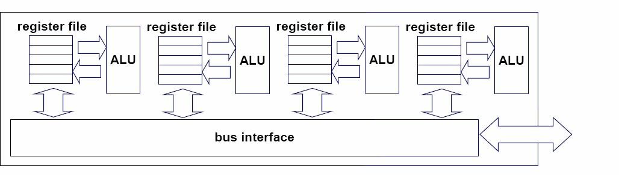
Multi-core architectures
Replicate multiple processor cores on a single die.
Core 1 Core 2 Core 3 Core 4
Multi-core CPU chip

Slide 34
Multi-core CPU chip
The cores fit on a single processor socket
Also called CMP (Chip Multi-Processor)
c o r e 1 | c o r e 2 | c o r e 3 | c o r e 4

Slide 35
The cores run in parallel
thread 1 thread 2 thread 3 thread 4
c
c
c
c
o
o
o
o
r e
r e
r e
r e
1
2
3
4

Slide 36
Within each core, threads are time-sliced (just like on a uniprocessor)
several threads
several threads
several threads
several threads
c
c
c
c
o
o
o
o
r e
r e
r e
r e
1
2
3
4

Slide 37
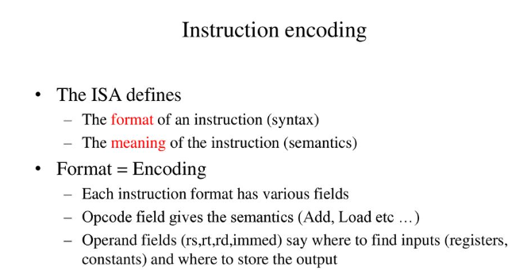

Slide 38
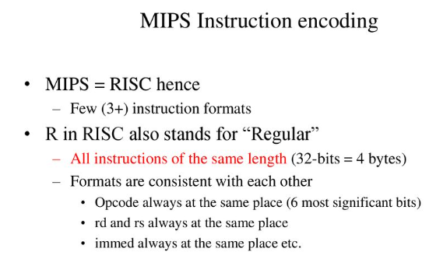

Slide 39
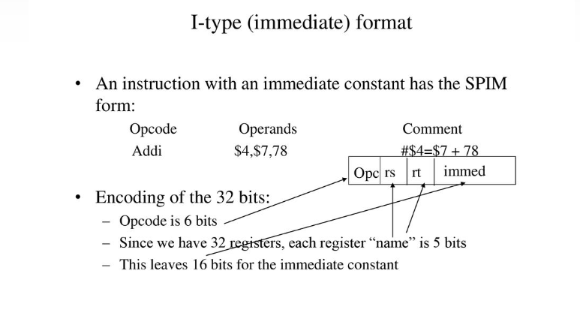

Slide 40
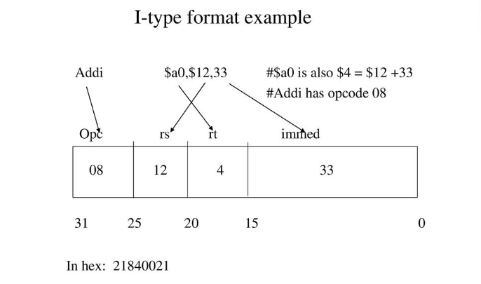

Slide 41
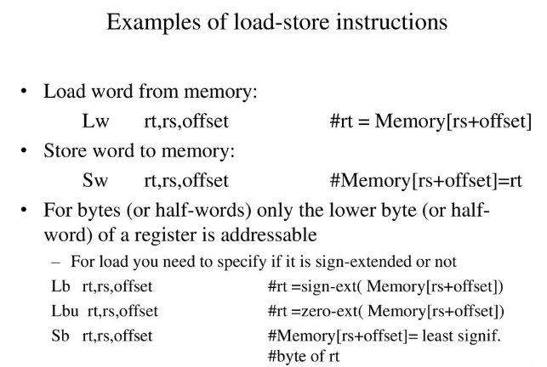

Slide 42
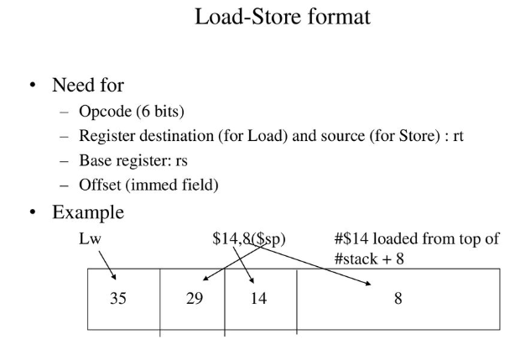

Slide 43
